Slide 1
Multiple Regression
STAT 101
Dr. Kari Lock Morgan
SECTION 10.3
Variable selection
Confounding variables revisited
Brief look at logistic regression

Slide 2
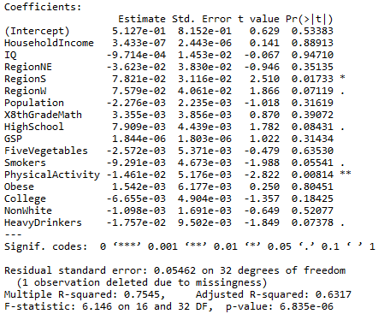
Model Output

Slide 3
R² versus Adjusted R²
If you want to evaluate the success of the model, in terms of the percentage of the variability in the response explained by the explanatory variables, you would use
R²
Adjusted R²

Slide 4
R² versus Adjusted R²
If you want to compare two competing models and decide whether a certain explanatory should be included or not, you would use
R²
Adjusted R²
R² always increases or stays the same with additional explanatory variables, even if they are worthless.
Adjusted R² should go down if non-useful variables are added.

Slide 5
Variable Selection
The p-value for an explanatory variable can be taken as a rough measure for how helpful that explanatory variable is to the model
Insignificant variables may be pruned from the model, as long as adjusted R² doesn’t decrease
You can also look at relationships between explanatory variables; if two are strongly associated, perhaps both are not necessary

Slide 6
Variable Selection
(Some) ways of deciding whether a variable should be included in the model or not:
Does it improve adjusted R²?
Does it have a low p-value?
Is it associated with the response by itself?
Is it strongly associated with another explanatory variables? (If yes, then including both may be redundant)
Does common sense say it should contribute to the model?

Slide 7
Stepwise Regression
We could go through and think hard about which variables to include, or we could automate the process
Stepwise regression drops insignificant variables one by one
This is particularly useful if you have many potential explanatory variables

Slide 8
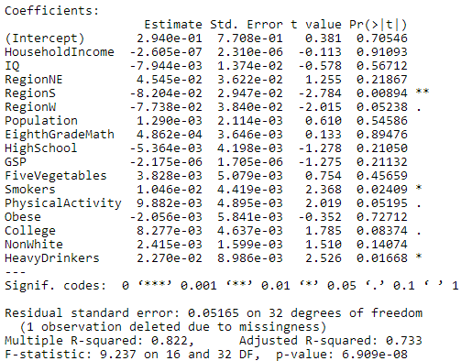
Full Model
Highest p-value

Slide 9
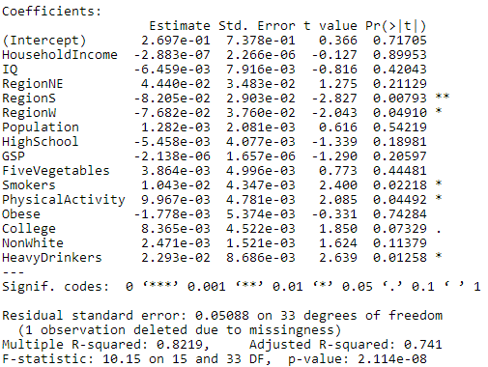
Pruned Model 1
Highest p-value

Slide 10
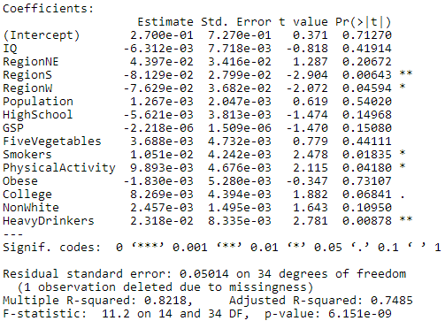
Pruned Model 2
Highest p-value

Slide 11
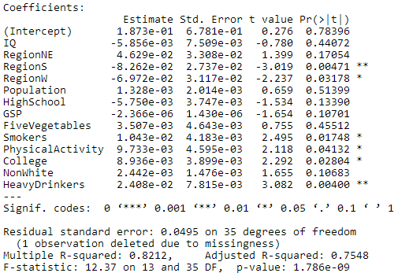
Pruned Model 3
Highest p-value

Slide 12
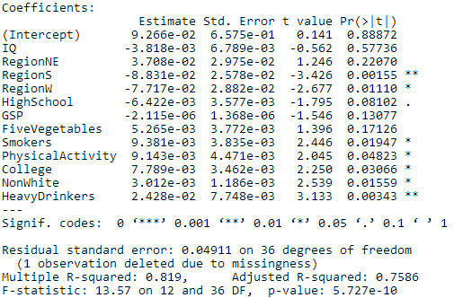
Pruned Model 4
Highest p-value

Slide 13
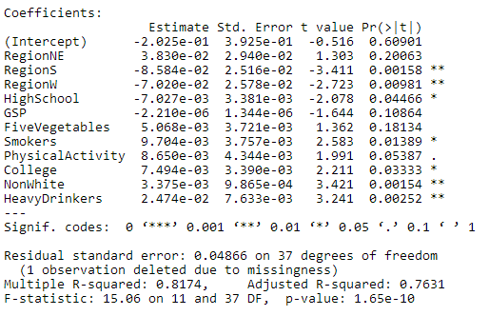
Pruned Model 5
Highest p-value

Slide 14
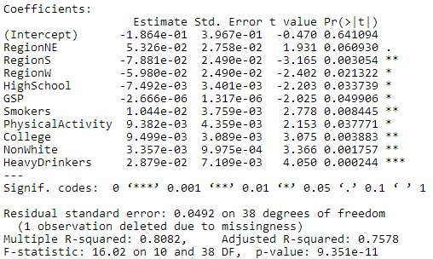
Pruned Model 6

Slide 15
Pruned Model 5

Slide 16
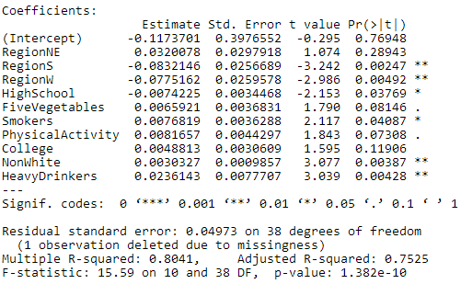
Pruned Model 7

Slide 17
Pruned Model 5
FINAL STEPWISE MODEL

Slide 18
Full Model

Slide 19
Variable Selection
There is no one “best” model
Choosing a model is just as much an art as a science
Adjusted R² is just one possible criteria
To learn much more about choosing the best model, take STAT 210

Slide 20
Electricity and Life Expectancy
Cases: countries of the world
Response variable: life expectancy
Explanatory variable: electricity use (kWh per capita)
Is a country’s electricity use helpful in predicting life expectancy?

Slide 21
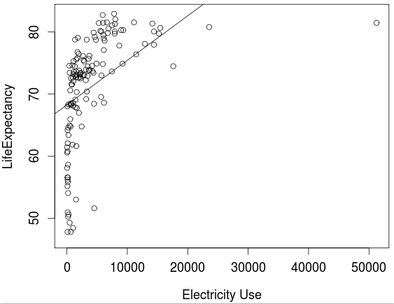
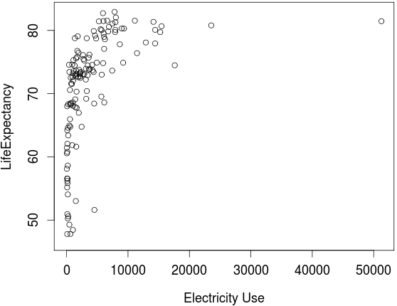
Electricity and Life Expectancy

Slide 22
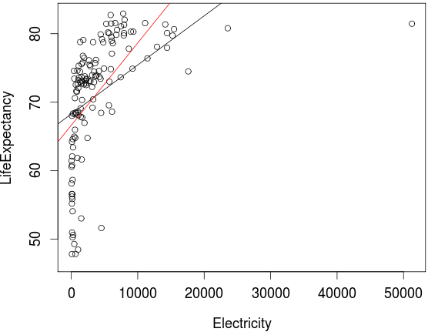
Electricity and Life Expectancy
Outlier: Iceland

Slide 23
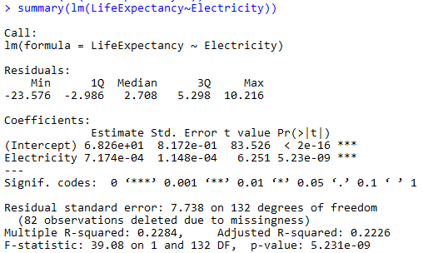
Electricity and Life Expectancy

Slide 24
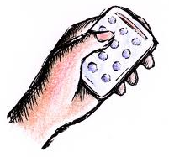
Electricity and Life Expectancy
Is this a good model for predicting life expectancy based on electricity use?
(a) Yes
(b) No
The association is definitely not linear.

Slide 25
Electricity and Life Expectancy
Is a country’s electricity use helpful in predicting life expectancy?
(a) Yes
(b) No
The p-value for electricity is significant.

Slide 26
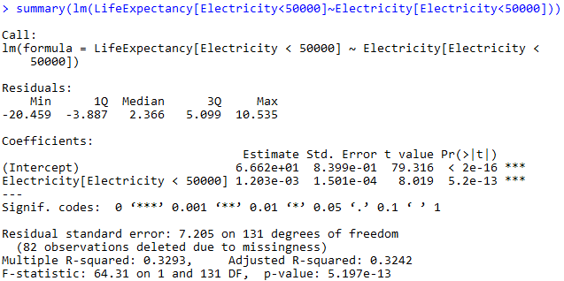
Electricity and Life Expectancy

Slide 27
Electricity and Life Expectancy
If we increased electricity use in a country, would life expectancy increase?
(a) Yes
(b) No
(c) Impossible to tell
We cannot make any conclusions about causality, because this is observational data.

Slide 28
Electricity and Life Expectancy
If we increased electricity use in a country, would life expectancy increase?
(a) Yes
(b) No
(c) Impossible to tell
We cannot make any conclusions about causality, because this is observational data.

Slide 29
Confounding Variables
Wealth is an obvious confounding variable that could explain the relationship between electricity use and life expectancy
Multiple regression is a powerful tool that allows us to account for confounding variables
We can see whether an explanatory variable is still significant, even after including potential confounding variables in the model

Slide 30
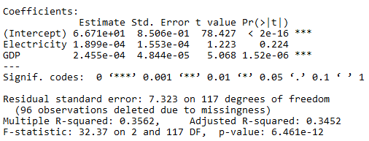
Electricity and Life Expectancy
Is a country’s electricity use helpful in predicting life expectancy, even after including GDP in the model?
(a) Yes (b) No
Once GDP is accounted for, electricity use is no longer a significant predictor of life expectancy.

Slide 31
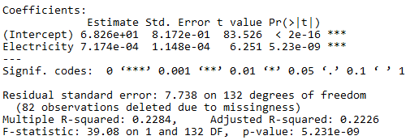
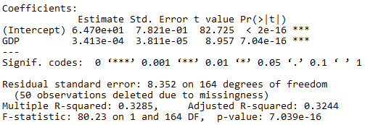
Which is the “best” model?
(a)
You could argue for (c) as well, but I would choose (b), because it has the highest adjusted R²
(b)
(c)

Slide 32
Cell Phones and Life Expectancy
Cases: countries of the world
Response variable: life expectancy
Explanatory variable: number of mobile cellular subscriptions per 100 people
Is a country’s cell phone subscription rate helpful in predicting life expectancy?

Slide 33
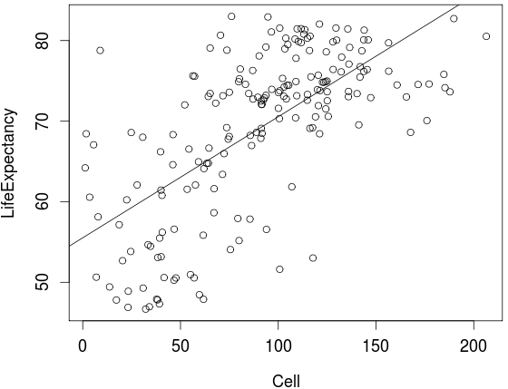
Cell Phones and Life Expectancy

Slide 34
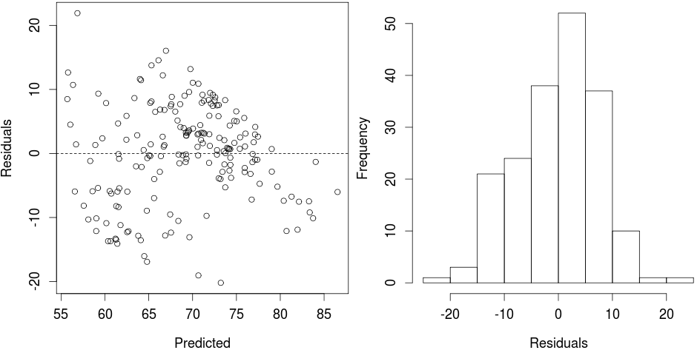
Cell Phones and Life Expectancy

Slide 35
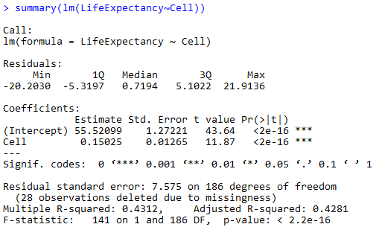
Cell Phones and Life Expectancy

Slide 36
Cell Phones and Life Expectancy
Is this a good model for predicting life expectancy based on cell phone subscriptions?
(a) Yes
(b) No
The association is linear, the variability seems approximately constant, and the residuals look approximately normal.
There is a bit of concern by the slight possible downward trend towards the end of the residual plot, so if you answered no for that reason, that is okay as well.

Slide 37
Cell Phones and Life Expectancy
Is a country’s number of cell phone subscriptions per capita helpful in predicting life expectancy?
(a) Yes
(b) No
The p-value for cell indicates strong significance.

Slide 38
Cell Phones and Life Expectancy
If we gave everyone in a country a cell phone and a cell phone subscription, would life expectancy in that country increase?
(a) Yes
(b) No
(c) Impossible to tell
Again, we cannot make causal conclusions.

Slide 39

Cell Phones and Life Expectancy
Is a country’s cell phone subscription rate helpful in predicting life expectancy, even after including GDP in the model?
(a) Yes (b) No
The p-value for Cell still denotes strong significance, even with GDP in the model.
Even after accounting for GDP, cell phone subscriptions per capita is still a significant predictor of life expectancy.

Slide 40
Cell Phones and Life Expectancy
This says that wealth alone can not explain the association between cell phone subscriptions and life expectancy
This suggests that either cell phones actually do something to increase life expectancy (causal) OR there is another confounding variable besides wealth of the country

Slide 41
Confounding Variables
Multiple regression is one potential way to account for confounding variables
This is most commonly used in practice across a wide variety of fields, but is quite sensitive to the conditions for the linear model (particularly linearity)
You can only “rule out” confounding variables that you have data on, so it is still very hard to make true causal conclusions without a randomized experiment

Slide 42
To Do
Read 10.3
Do Homework 8 (due Wednesday, 4/16)
Do Project 2 (due Wednesday, 4/23)

